Slide 1
Microcontroller Overview
Difference between a microprocessor and micro controller :
A microcontroller has in built peripherals like timers, USART, Interrupt controller etc.Where as in a microprocessor these have to be interfaced as separate IC’s.
Microprocessor is Byte addressable & Microcontroller is Bit as well as Byte addressable

Slide 2
Why 89C51 is used?
In 8051,Instruction memory used is ROM
In 8751, Instruction memory used is EPROM
In 8951, Instruction memory used is EEPROM/Flash ROM

Slide 3
Microcontroller AT89C51 from ATMEL Corp.
Part Summary
Manufacturer
Manufacturer's Part Number
Manufacturer's Web Site
Futurlec Part Number
Department
Category
Package Type
Package Qty
Atmel
AT89C51-20PC
www.atmel.com
AT89C51-20PC
Integrated Circuits
Microcontrollers - Atmel
40 Pin DIP
1

Slide 4
Features of 89C51
Compatible with MCS-51TM products
4K Bytes of In-System Reprogrammable flash memory
Endurance:1000 Write/erase cycles
Fully static operation:0 Hz-24 MHz
Three level Program memory lock
128 x 8-Bit Internal RAM

Slide 5
Features of 89C51 (Contd.)
32 Programmable I/O lines
Two 16-Bit Timer/Counters
Six Interrupt Sources
Programmable Serial Channel
Low-Power Idle and Power-Down Modes
works on TTL logic

Slide 6
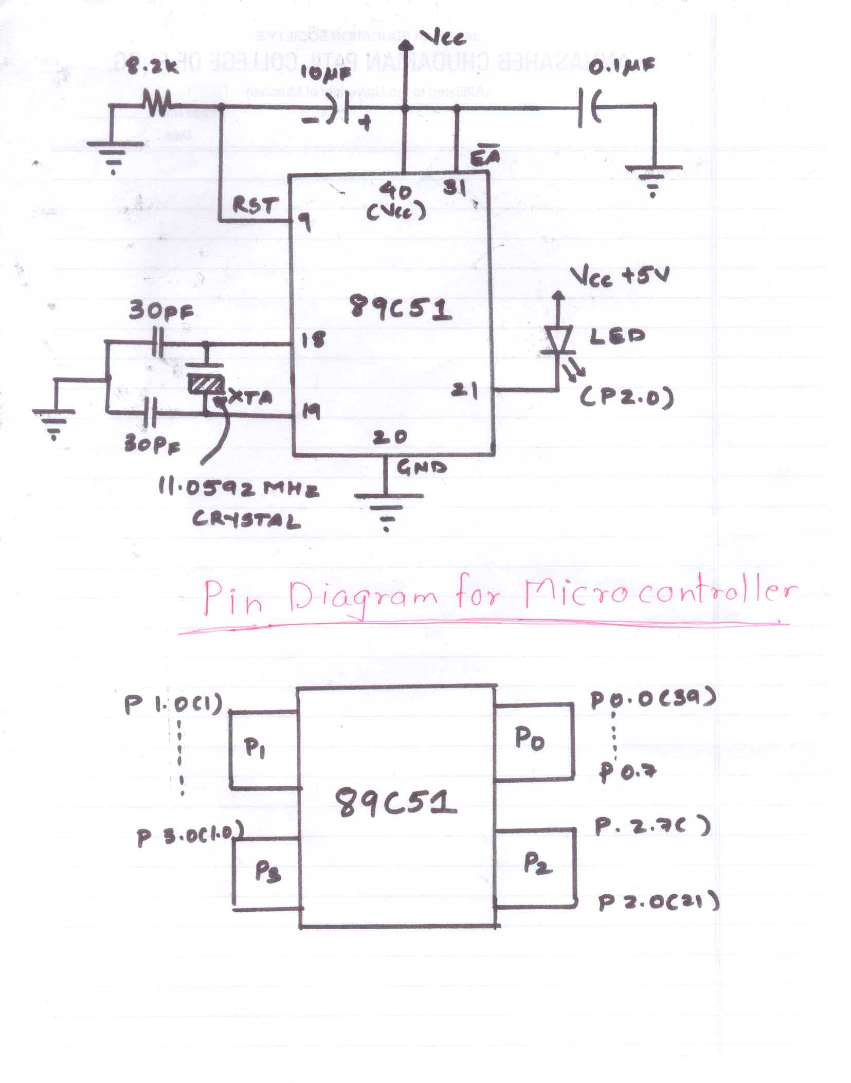
Pin Diagram of microcontroller

Slide 7
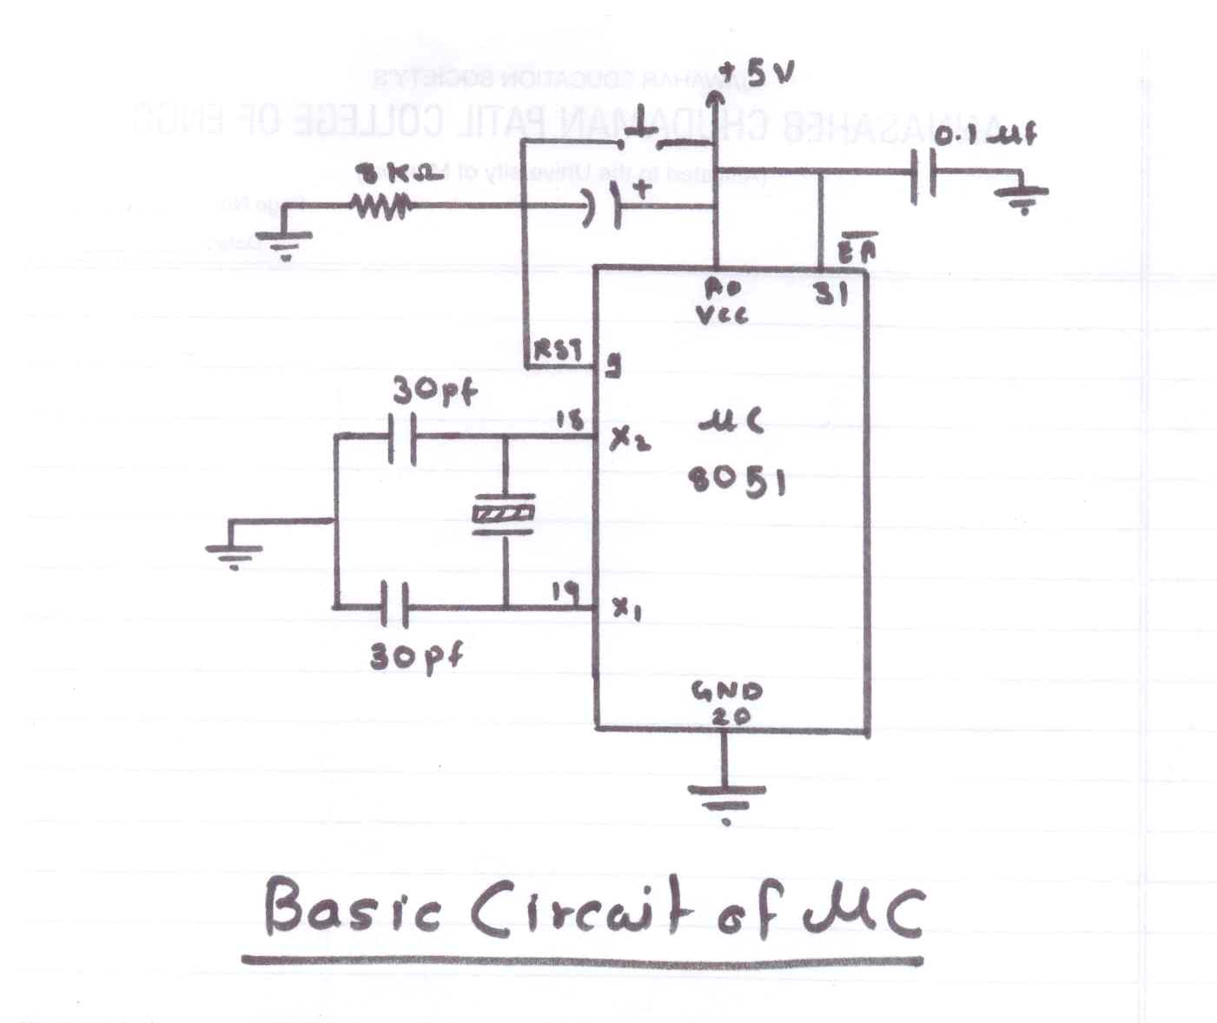
Basic Circuit of Microcontroller to work properly

Slide 8
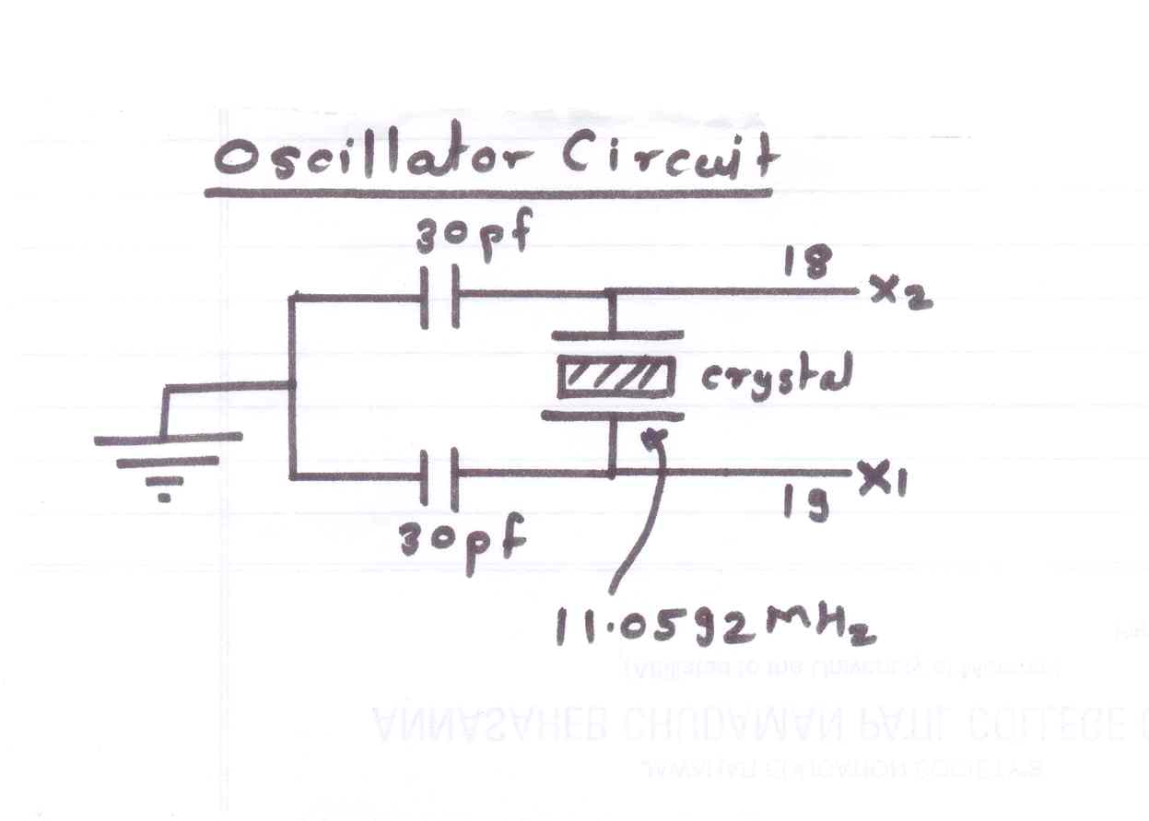
Oscillator circuit

Slide 9
Oscillator circuit (Contd.)
Oscillator circuit is used to generate clock frequency that is square wave
It is used to synchronize operation of internal block of micro controller
For communication purpose, to achieve specific baud rate we require 11.0592 MHz crystal.
12 MHz crystal is used for time based applications

Slide 10
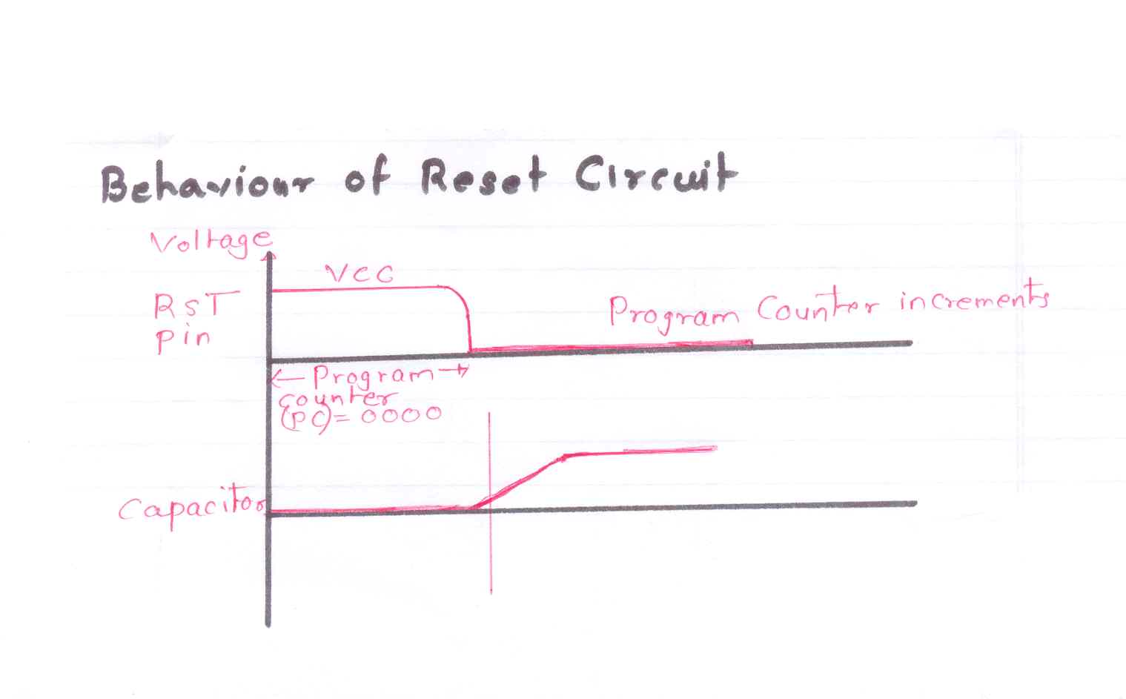
Behavior of Power On Reset circuit

Slide 11
Memory Selection
complement of EA-external address
EA is used to enable external ROM, if we are writing longer code.
If EA = VCC,then the code fetched from internal memory
If EA = GND,then the code is fetched from external memory

Slide 12
Serial Communication
Baud Rate:-
In addition to voltage ranges,RS-232 Protocol identifies how fast data is transmitted between two ports.
This transmission speed is defined as baud rate-roughly equivalent to the number of bits transmitted per second.

Slide 13
Serial Communication (Contd.)
Range of Baud rates-
* 110 bps
* 300 bps
* 1200 bps
* 4800 bps
* 9600 bps (Baud rate required for micro controller to work)
*115200 bps (Maximum Baud rate available for PC based applications)

Slide 14
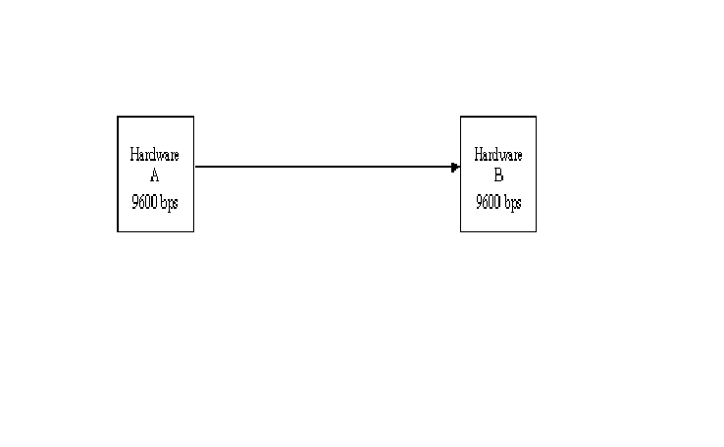
Serial Communication (Contd.)
Asynchronous communication takes place between hardware A and hardware B i.e. clock cycle is not present.

Slide 15
Null Modem Connection
PC assumed that there is MODEM but it is virtual., Hence is called as Null Modem.
The standards show the use of DTE/DCE communication, the way a computer should communicate with a peripheral device like a modem.
DTE ->data terminal equipment (computers etc.)
DCE -> data communication equipment (modems).

Slide 16
Null Modem Connection (Contd.)
uses of serial communication
* where no modem is involved—a serial null modem configuration with DTE/DTE communication—is not so well defined, especially when it comes to flow control.
* The terminology null modem for the situation where two computers communicate directly is so often used nowadays.

Slide 17
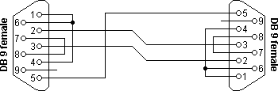
Null Modem Connection (Contd.)
Null modem with loop back handshaking

Slide 18
Connector 1 | Connector 2 | Function
2 | 3 | Rx<-Tx
3 | 2 | Tx->Rx
5 | 5 | Signal ground
1+4+6 | - | DTR->CD + DTR
- | 1+4+6 | DTR->CD + DTR
7+8 | - | RTS->CTS
- | 7+8 | RTS->CTS

Slide 19
Null Modem Connection (Contd.)
RTS->Request To Send
CTS->Clear To Send
-Pin 1,4 & 6 are short because pin 1 send RTS and Pin 4 accepts CTS.
In Null Modem connection, Pin 1,4 and 6 are short which indicates that both signals (CTS and RTS) are sent and received from Modem.

Slide 20
Null Modem Connection (Contd.)
The main purpose of this null modem cable is to let well defined software think there is handshaking available, with a null modem cable which has no provisions for it.

Slide 21
Level Converter/Logic converter
Level converter is used to convert the voltage level between PC and micro controller.
It is designed with MAX 232 IC.
TTL logic-
Logic 1 - +5 Volts
Logic 0- 0 volts
RS-232 Logic-
Logic 1- -10 Volts
Logic 0- +10 volts

Slide 22
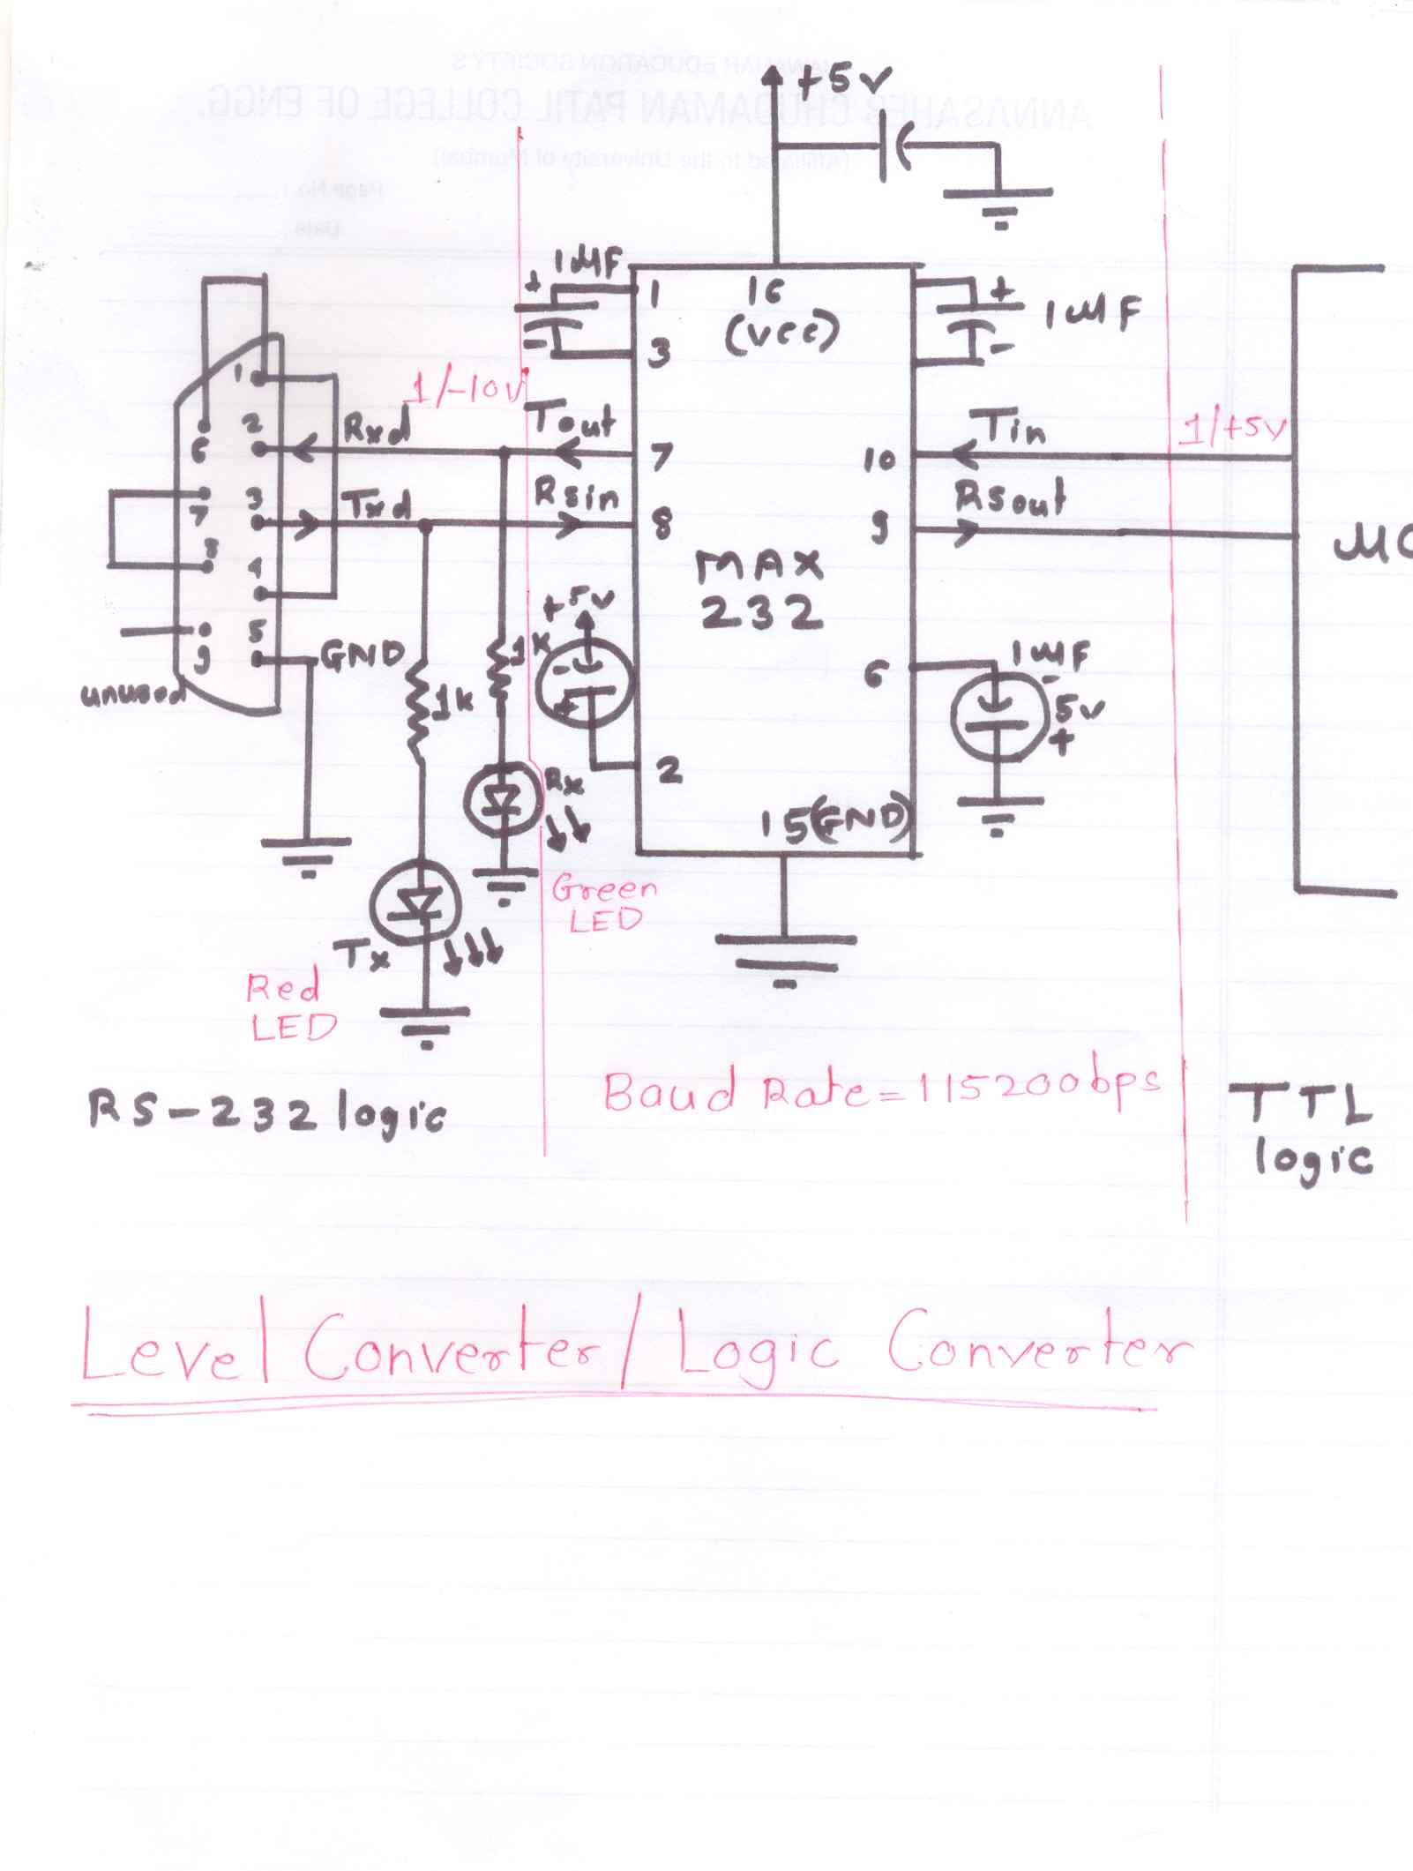
Pin Diagram

Slide 23
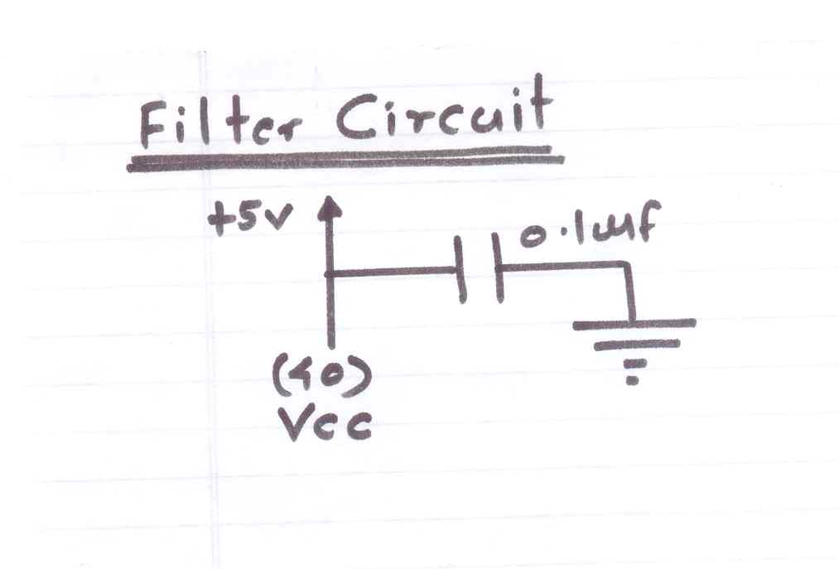
Filter Circuit
It is used to avoid oscillation in AC voltage.
A capacitor is connected near to VCC (Pin no. 16) such that less number of oscillations will enter in circuit.

Slide 24
Level Converter/Logic converter (Contd.)
TX LED indicates data is transmitted from PC to micro controller.
RX LED indicates data is transmitted from micro controller to PC.

Slide 25
Level Converter/Logic converter (Contd.)
Charge Pumping principle-
Voltage on Pin 2 and Pin 6 is pumped in T out to generate -10 volts.
IC can sustain at baud rate of 115200 bps.
With more than 115200 bps,the IC cannot pump the charge.
Pull up->raise the voltage to VCC
Pull down->low down the voltage to GND

Slide 26
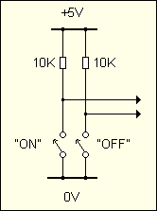
LED Blinking

Slide 27
Code for LED Blinking
(In Assembly Language)
Repeat:
Clr P2.0
acall Delay
Set b P2.0
acall Delay
ajmp Repeat
Delay:
.
.
.
NOP
.
RETURN

Slide 28
Code for LED Blinking
(In Embedded ‘C’)
#include”LI89C51.h”
void Delay(void);
void main(void)
{
while(1)
{
P2_0=0;
Delay();
P2_0=1;
Delay();
}
while(1);/*The condition will keep microcontroller busy otherwise it will generate garbage value*/
}
void Delay(void)
{
unsigned int i;
for(i=0;i<=30000,i++);
}

Slide 29
Logic For Code Of LED blinking in Embedded C
Logic :
0 -> LED is ON
1 -> LED is OFF

